Slide 1

Automated Handwritten Digit Recognition using CNN
Deep Learning for MNIST Classification
Python filename: mnist_digit_recognizer.py
Test accuracy: 99.14%
Key Metric: Test Accuracy 99.14%

Slide 2
Problem Statement
Objective
Real-world Applications
Goal
Build a computer vision system to automatically recognize and classify handwritten digits (0-9) with high accuracy.
automated bank check reading, postal mail sorting, and form digitization.
Develop a deep learning model that generalizes well to unseen handwriting styles.

Slide 3
Dataset Overview: MNIST
Structure
Data Split
70,000 grayscale images of handwritten digits.
Training Set 60,000 images
Testing Set 10,000 images.
Image Dimensions
Normalization
28×28 pixels (28×28×1 channel).
Pixel values normalized from 0-255 to [0, 1] range to accelerate model convergence.

Slide 4

Key Insights from EDA & Visualization
Uniformity
Visual Variance
Confusion Zones
Dataset is well-balanced across all 10 classes (digits 0-9), preventing class imbalance bias.
Significant variation in writing styles—different stroke thickness, slant, and loop sizes.
Potential confusion between similar digits like '1' vs '7', '3' vs '5', '4' vs '9'.

Slide 5
CNN Architecture
Input Layer
28×28×1 image.
Feature Extraction Block 1
Conv2D (32 filters) → BatchNorm → ReLU → MaxPooling.
Feature Extraction Block 2
Conv2D (64 filters) → BatchNorm → ReLU → MaxPooling.
Classification Head
Flatten → Dense (128 units, ReLU) → Dropout (0.5) → Output (10 units, Softmax).
Optimizer & Parameters
Optimizer: Adam (learning_rate=0.001). Total params: 422,026 (1.61 MB).

Slide 6
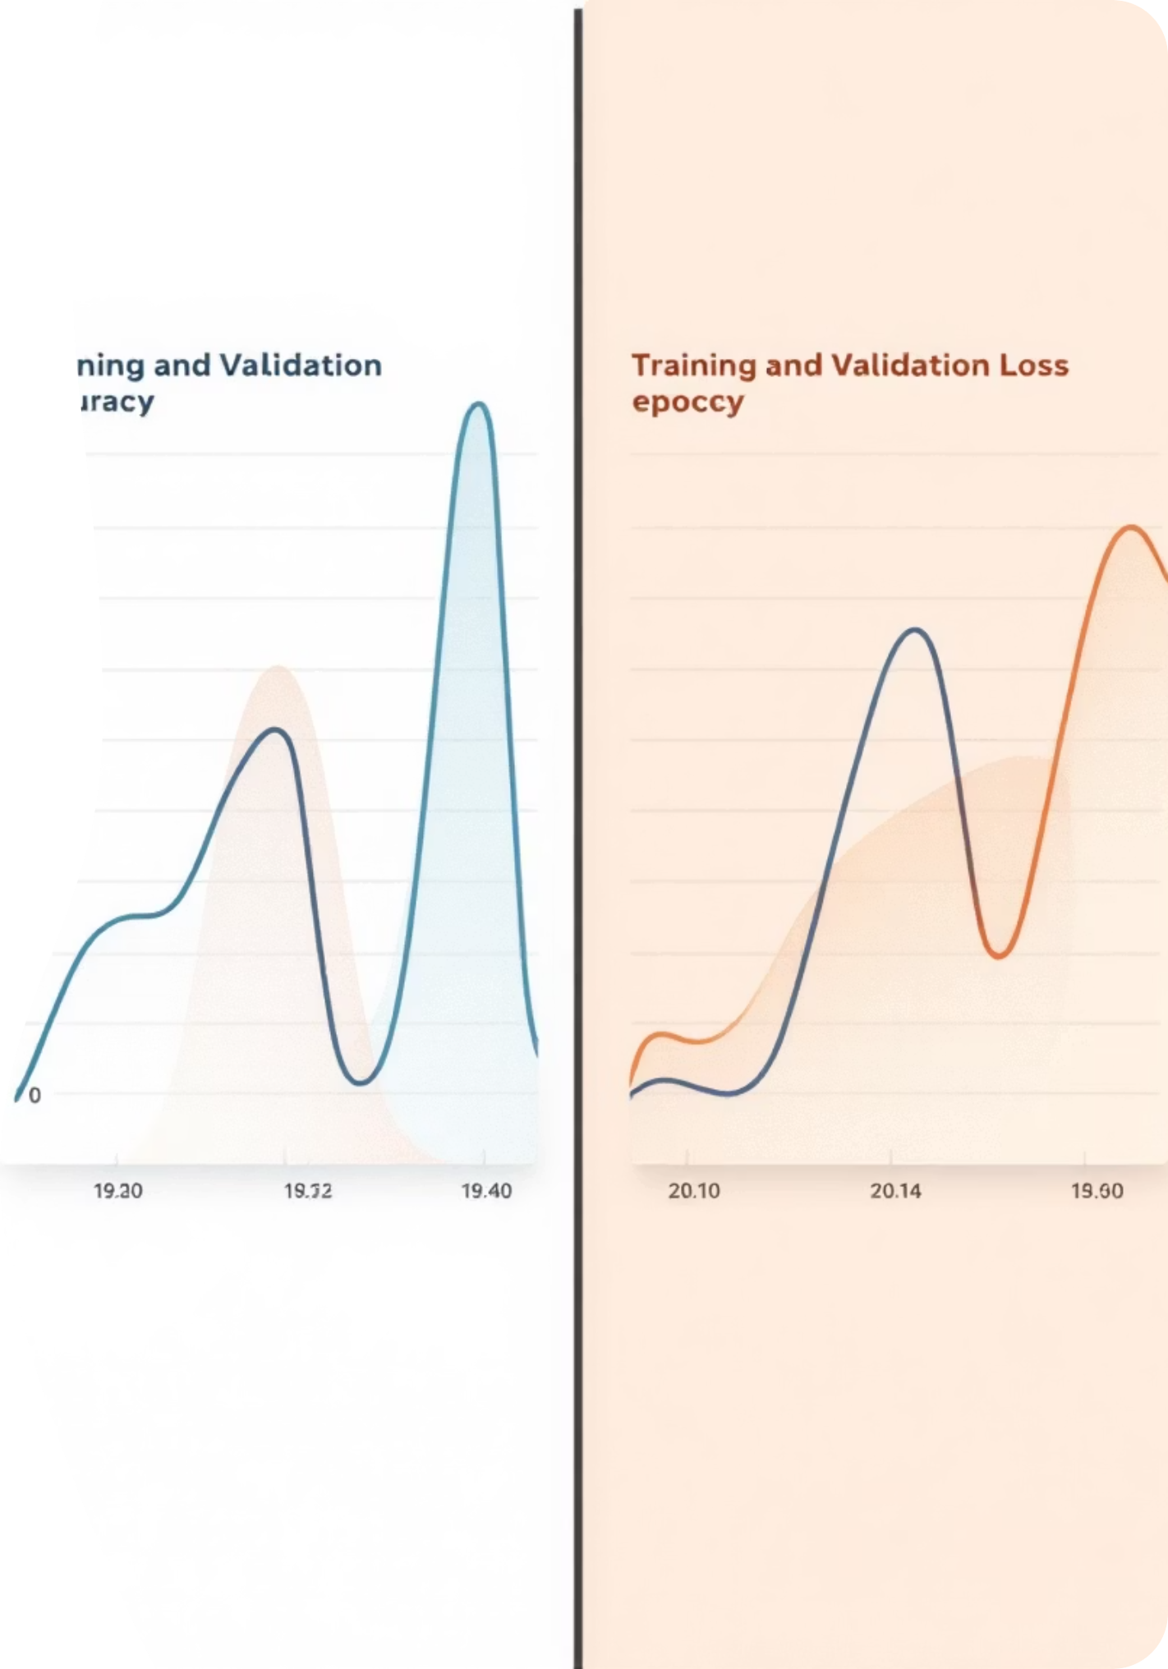
Training Performance
Convergence
Model converged rapidly. By Epoch 2, validation accuracy was already ~98.7%.
Early Stopping
Training was stable with validation loss steadily decreasing from 0.208 to 0.028 over 10 epochs.
Final Results
Training Accuracy ~99.03%, Validation Accuracy ~99.28%, Test Accuracy 99.14%.

Slide 7

Model Evaluation & Predictions
Confusion Matrix
Classification Report
Model shows near-perfect diagonal dominance with very few misclassifications.
Precision, Recall, and F1-Score are ≥0.99 for almost every digit class, indicating exceptional reliability.
Sample Predictions
The model correctly predicts handwritten digits with high confidence.

Slide 8

Confusion Matrix Analysis
The diagonal dominance indicates excellent classification performance. Misclassifications are minimal and occur primarily between visually similar digits (e.g., a few '4's confused as '9's, likely due to messy handwriting).

Slide 9
Key Conclusions
High Reliability
Robustness
Efficiency
Test accuracy of 99.14% confirms the CNN architecture is highly effective, significantly outperforming traditional ML methods (SVM, KNN).
Batch Normalization and Dropout successfully prevented overfitting—Test Accuracy (99.14%) exceeds Training Accuracy (99.03%).
Achieved state-of-the-art results in just 10 epochs (~4 minutes), making it computationally efficient.

Slide 10
Recommendations & Next Steps
1
2
3
Data Augmentation
Deployment
Error Analysis
Apply real-time augmentation (random rotations, zooms, shifts) during training to simulate messier handwriting and push accuracy towards 99.8%.
Model is lightweight (1.6 MB) and accurate enough for deployment in mobile apps (via TensorFlow Lite) or web services for real-time digit recognition.
Investigate the remaining <1% errors—likely ambiguous digits that even humans might misread. Specialized fine-tuning could address these 'hard' samples.

